Slide 1

Imagine Sarah, a college student, trying to buy a new laptop. She spends hours scrolling through countless websites, overwhelmed by the sheer variety of models, specifications, and wildly fluctuating prices. One day, a laptop is listed at a discount, only to see its price jump inexplicably the next. She’s left feeling frustrated and uncertain, wondering if she's getting a good deal or if she's about to overpay.
This scenario is all too common. The electronics market, especially for laptops, is a complex ecosystem with constant price adjustments driven by supply, demand, new model releases, and competitive pressures. For an average consumer, navigating this labyrinth of pricing can be a nightmare, leading to purchase anxiety and missed opportunities for savings.
But what if there was a way to cut through this confusion? What if we could predict laptop prices with a high degree of accuracy, empowering buyers like Sarah and providing invaluable insights for sellers? This is where the power of machine learning comes into play, transforming market uncertainty into actionable intelligence.
Laptop Price Prediction
Leveraging Machine Learning for Market Insights
Presented by Ahmed Bhbaty

Slide 2

Presentation Agenda
01
02
03
Objective
Data Overview
Exploratory Data Analysis (EDA)
Define project goals and business value.
Explore the dataset and its features.
Uncover initial patterns and distributions.
04
05
06
Feature Engineering
Correlation Analysis
Feature Importance Analysis
Create new, impactful features.
Identify relationships between features and price.
Determine the most influential factors.
07
08
09
Modeling
Model Validation & Testing
Business Applications & Recommendations
Apply various machine learning algorithms.
Assess model performance and robustness.
Translate insights into actionable strategies.
10
11
Conclusion & Future Outlook
Deployment & Live Demo
Summarize findings and outline next steps.
Showcase the working solution and its capabilities.

Slide 3
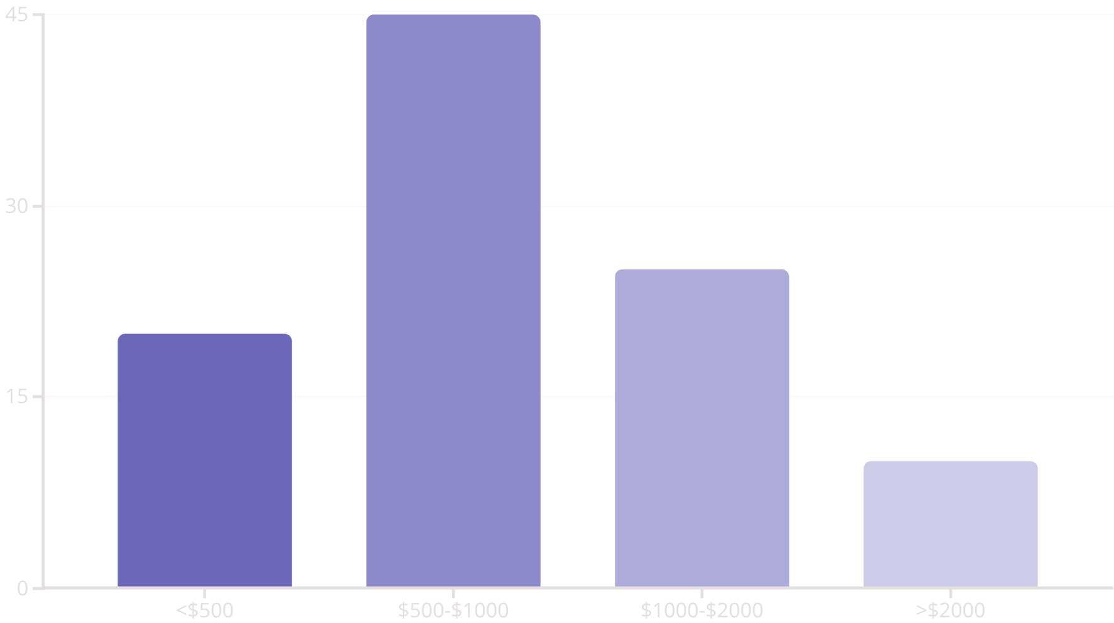
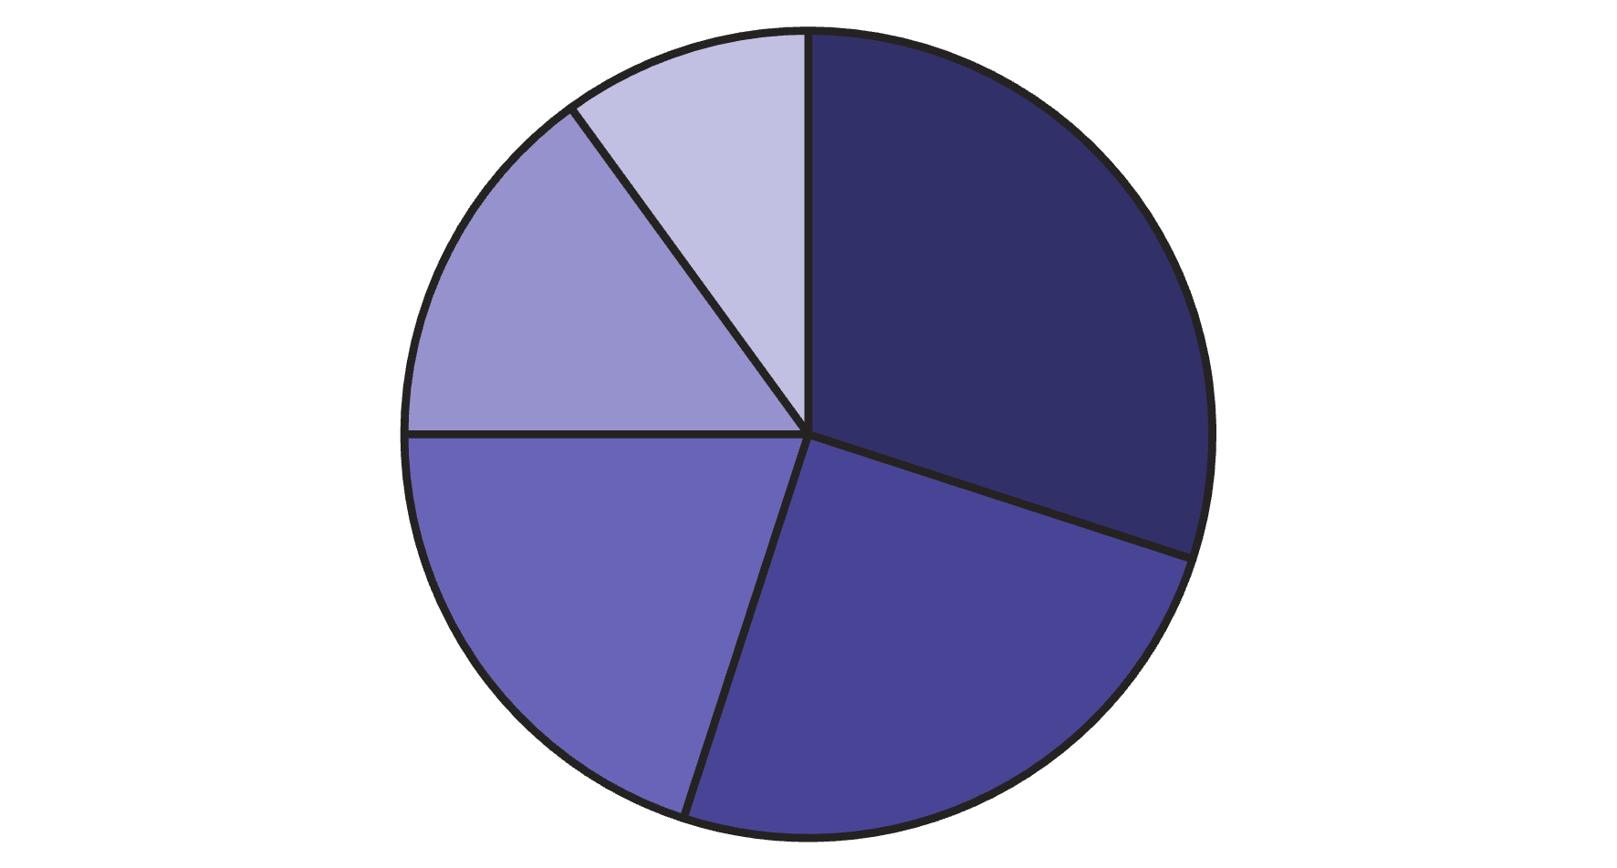
Project Objective
Predict Laptop Prices
Business Value
Develop a machine learning model to accurately predict laptop prices based on their specifications.
Pricing Guidance: Assist manufacturers and retailers in optimal pricing strategies.
Inventory Management: Optimize stock levels based on price segmentation.
Customer Insight: Understand key features driving customer purchasing decisions.
Analyzing laptop pricing across different segments provides valuable market insights.
Understanding the diverse market of laptops is key to accurate price prediction.
Gaming Laptops
Business Laptops
Ultrabooks
2-in-1 Convertibles
Budget Laptops

Slide 4

Dataset Overview
Our dataset comprises 1303 laptop entries, each described by 12 distinct features. This rich information allows for a comprehensive analysis of factors influencing laptop prices.
Company
Manufacturer
TypeName
Laptop category
Inches
Screen size
ScreenResolution
Display details
Cpu
Processor type
Ram
Memory (GB)
Memory
Storage type/size
Gpu
Graphics card
OpSys
Operating system
Weight
Laptop weight (kg)
Price
Target variable

Slide 5
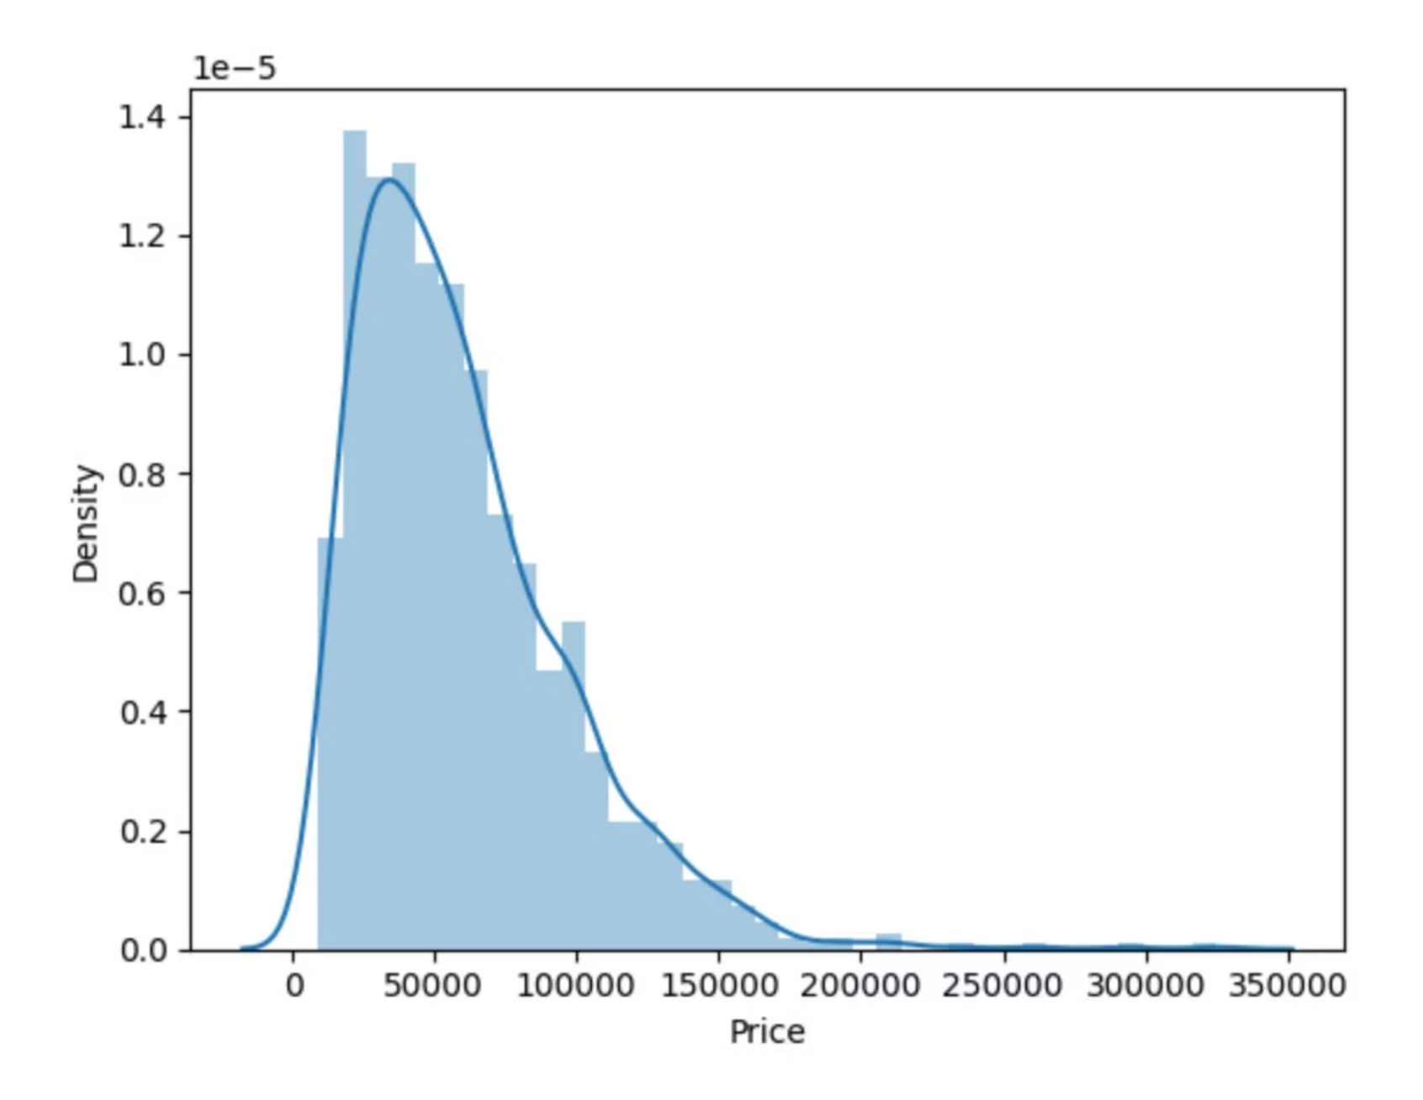
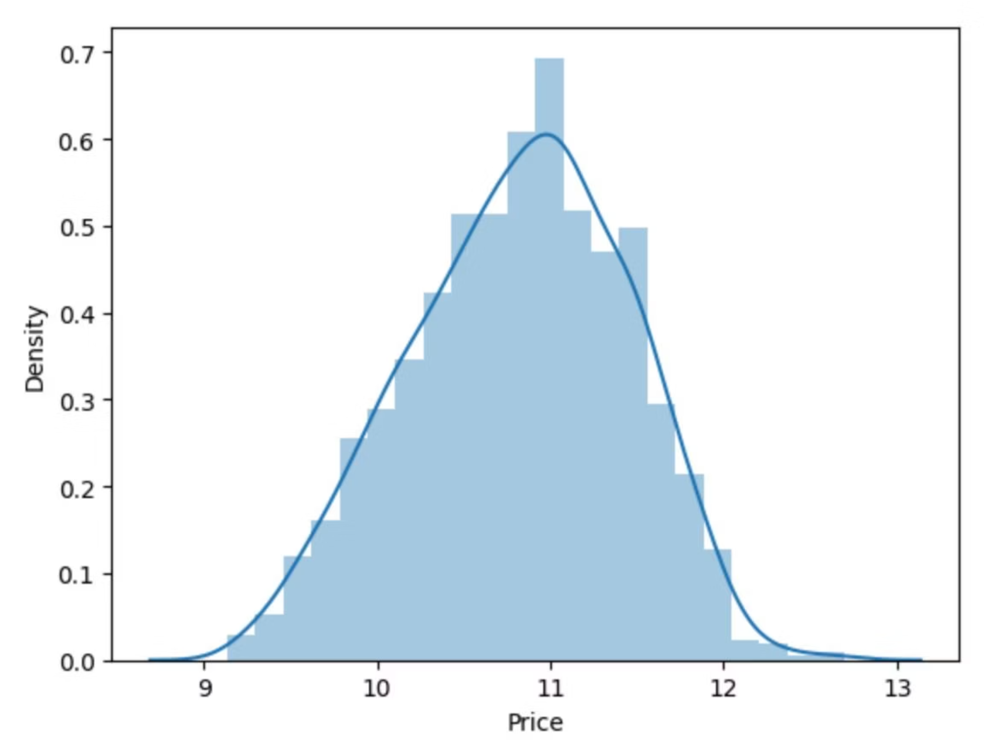
Exploratory Data Analysis (EDA)
Price Distribution & Transformation
The initial price distribution is skewed, indicating a higher frequency of cheaper laptops. This suggests that lower-priced goods are bought and sold more often.
To normalize this, a logarithmic transformation was applied to the 'Price' column, making the distribution more symmetrical for better model performance.

Slide 6
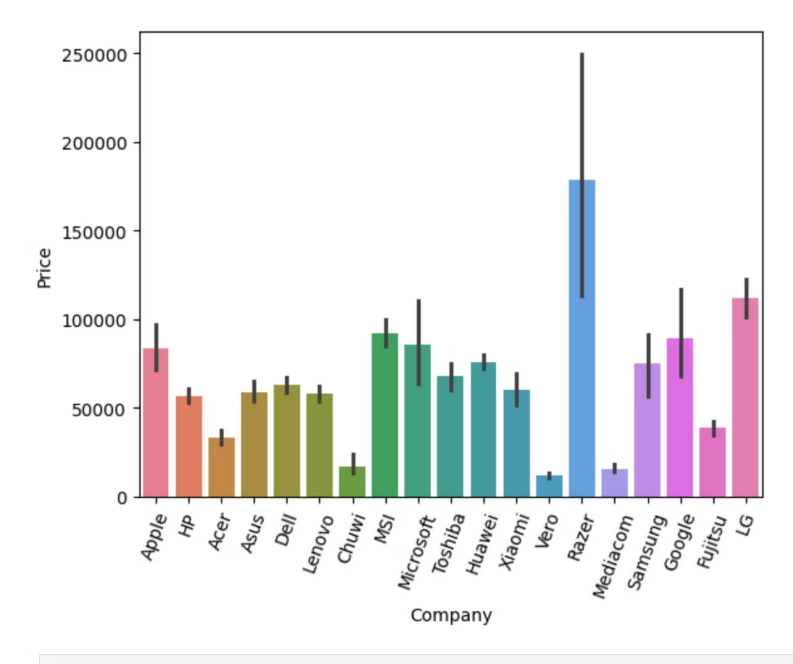
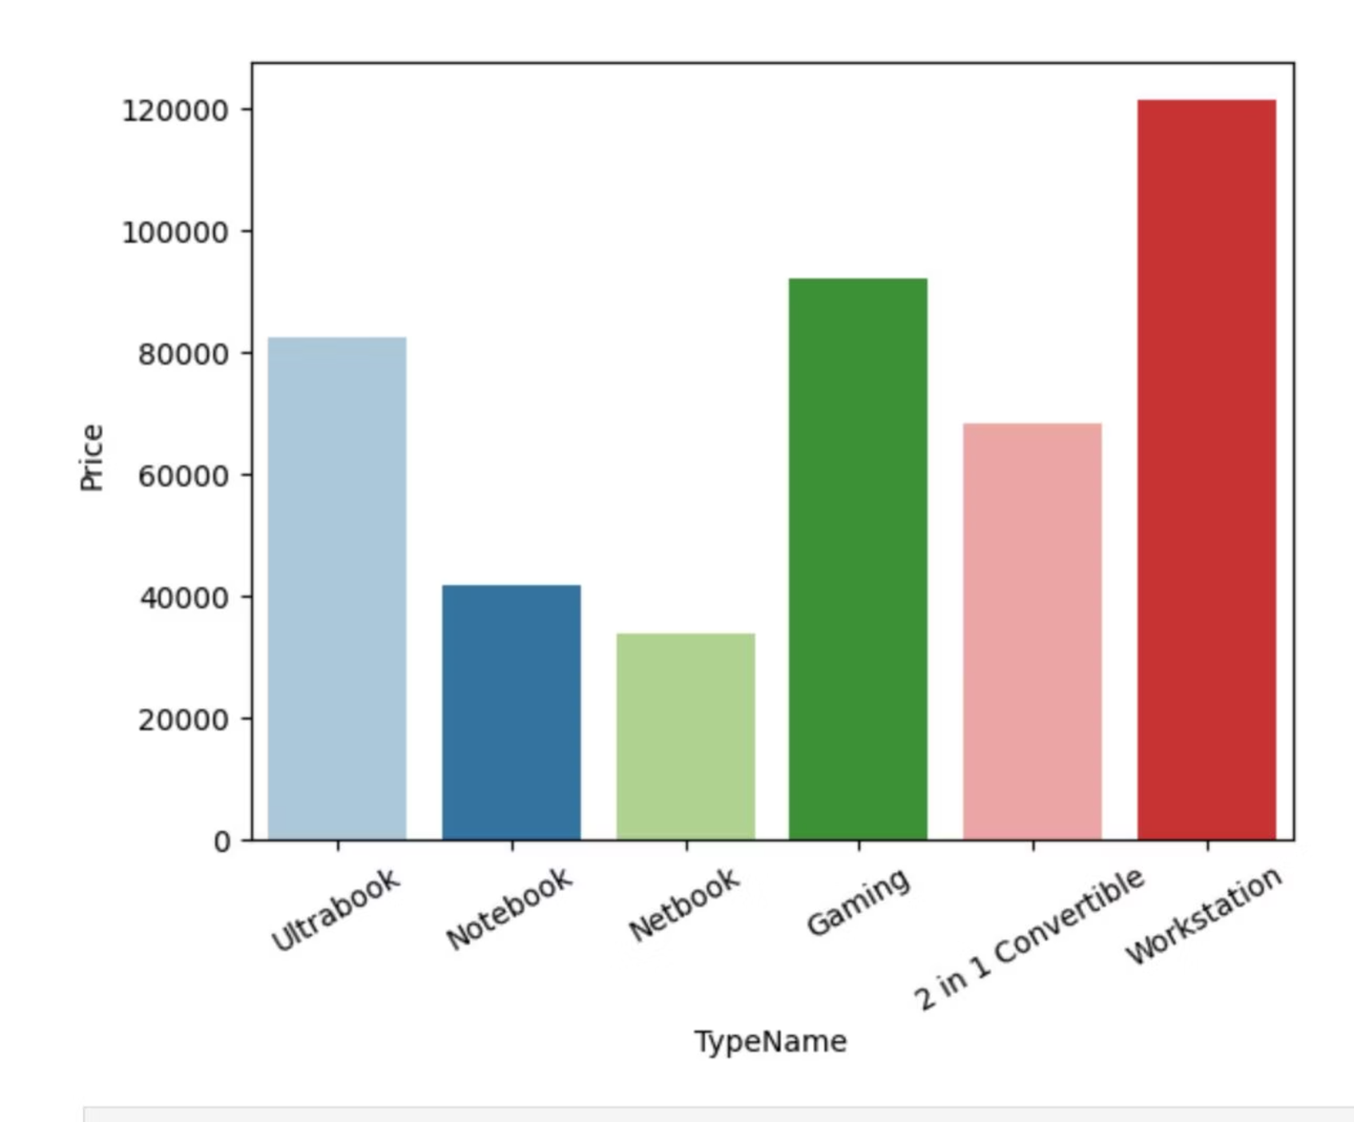
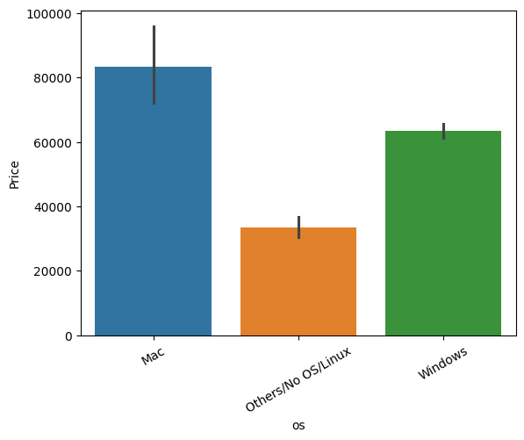
Key Price Drivers: Company, Type, & OS
Company vs. Price
Type vs. Price
OS vs. Price
Apple and MSI laptops generally command higher prices, while Acer and HP tend to be more affordable.
Workstation and Gaming laptops are the most expensive.
Mac OS devices are premium, Windows are mid-range, and Others/No OS/Linux are budget-friendly.

Slide 7
Feature Engineering: Enhancing Data
Deriving new features from existing ones is crucial for capturing more nuances and improving model accuracy.
Screen Features
CPU Brand
Touchscreen: Binary indicator (1/0).
Grouped into Intel Core i3/i5/i7, Other Intel, and AMD Processor.
IPS Panel: Binary indicator (1/0).
X_res & Y_res: Extracted screen resolutions.
Significant price differences observed across these categories.
PPI (Pixels Per Inch): Calculated for display sharpness.
Memory Features
GPU & OS Grouping
Split into HDD, SSD, Hybrid, and Flash Storage capacities.
GPU Brand: Extracted as Intel, Nvidia, or AMD.
OS: Categorized into Windows, Mac, and Others/No OS/Linux.
SSD storage strongly correlates with higher prices.

Slide 8
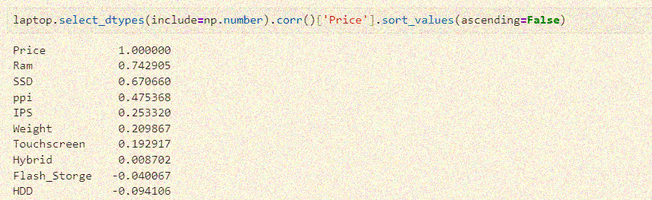

Correlation & Data Preparation
Correlation Insights
Data Preparation Steps
Categorical Encoding: Label encoding applied to 'Company', 'TypeName', 'Cpu_brand', 'Gpu_brand', 'os'.
Train/Test Split: Data divided into 80% training and 20% testing sets.
Feature Scaling: Numerical features scaled using StandardScaler.
Key features show strong positive correlations with price, while others have minimal or negative impact.
RAM (0.74): Highest positive correlation; more RAM strongly increases price.
SSD (0.67): Strong positive correlation; SSD storage significantly raises price.
PPI (0.47): Moderate positive correlation; higher screen resolution leads to higher prices.
HDD (-0.09): Negative correlation; laptops with HDDs are generally cheaper.
IPS (0.25): Weak positive correlation; IPS screens add some value.
Weight (0.21): Weak positive correlation; lighter laptops can be more expensive, but effect is small.
Touchscreen (0.19): Very weak positive correlation.
Hybrid (0.008): Almost no correlation with price.
Flash Storage (-0.04): Very weak negative correlation.
Summary: RAM and SSD are the strongest drivers of laptop prices, followed by PPI. HDD presence lowers price, while other features have only minor effects.

Slide 9
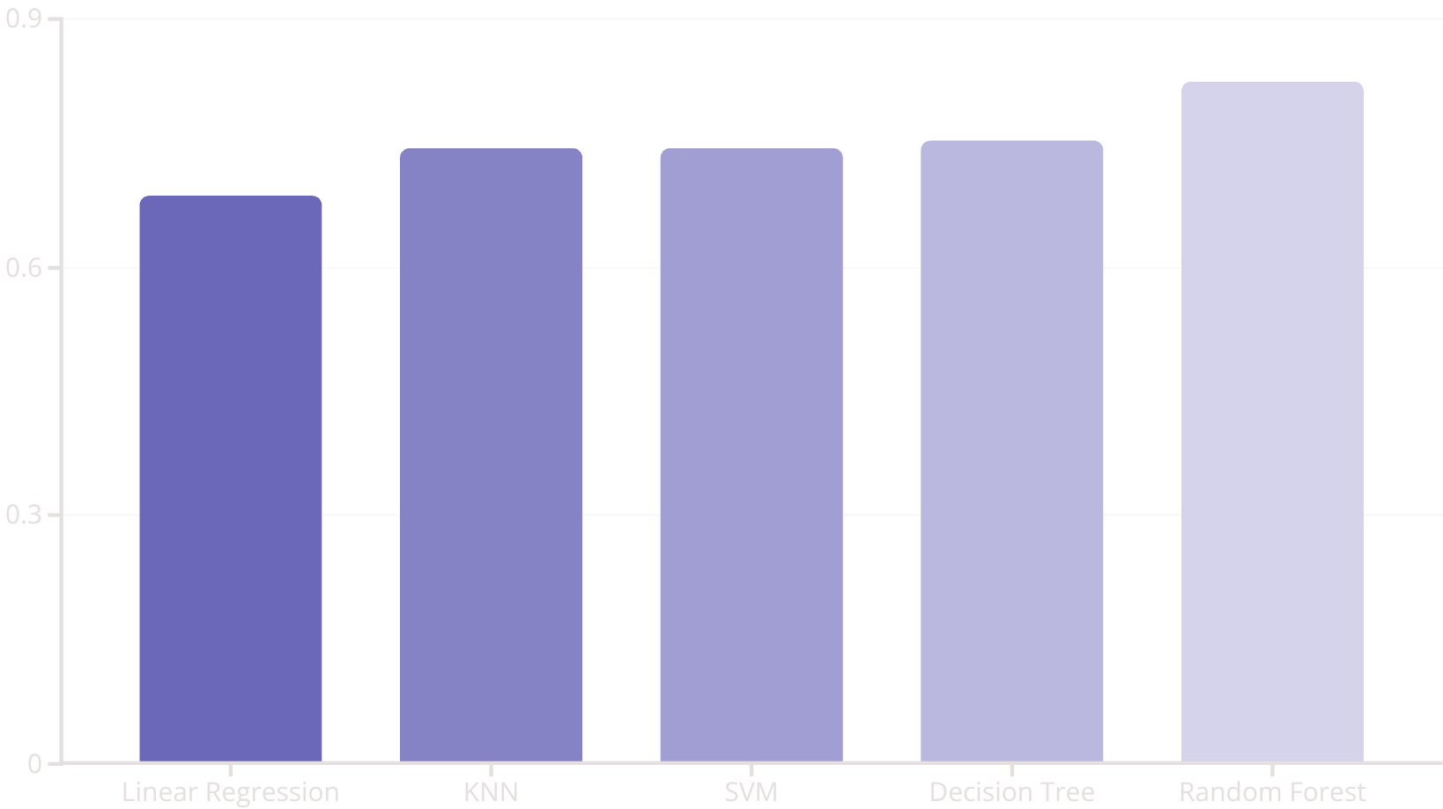
Modeling & Results
Machine Learning Models
Model Performance (R² Score)
Linear Regression
K-Nearest Neighbors (KNN)
Support Vector Machine (SVM)
Decision Tree
Random Forest
Evaluation Metrics
R² Score: Proportion of variance explained.
MAE: Mean Absolute Error.
RMSE: Root Mean Squared Error.
Random Forest achieved the highest R² score of 0.82, indicating superior predictive power.
Cross-Validation R²: Robustness of model performance.

Slide 10
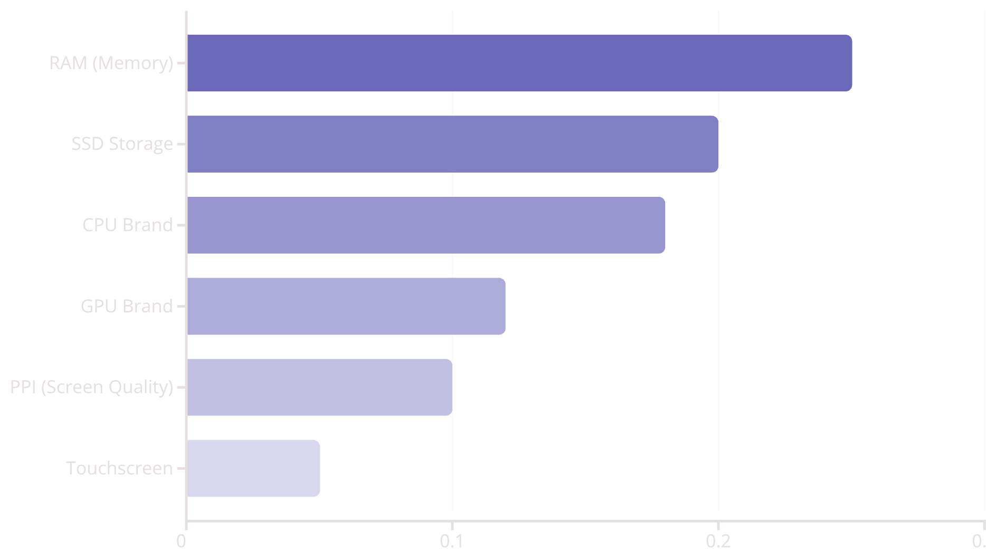
Feature Importance Analysis
Understanding which laptop features significantly influence price is crucial for strategic decision-making. Using the Random Forest model, we identified the most impactful factors that drive laptop pricing.
Why These Features Matter
RAM: Higher memory enables better multitasking and performance, directly correlating with a premium price.
SSD Storage: Faster boot times and application loading contribute significantly to user experience and price.
CPU Brand: Processor power and brand reputation (e.g., Intel i7) are key indicators of a laptop's overall capability.
GPU Brand: Dedicated graphics cards from brands like Nvidia or AMD are essential for gaming and professional tasks, commanding higher prices.
PPI (Screen Quality): Higher pixel density leads to sharper visuals, a feature often found in more expensive models.
The chart illustrates the relative importance of features, with RAM and SSD storage being the most influential.
Touchscreen: Adds a layer of interactivity and convenience, positioning laptops in a higher price bracket.

Slide 11
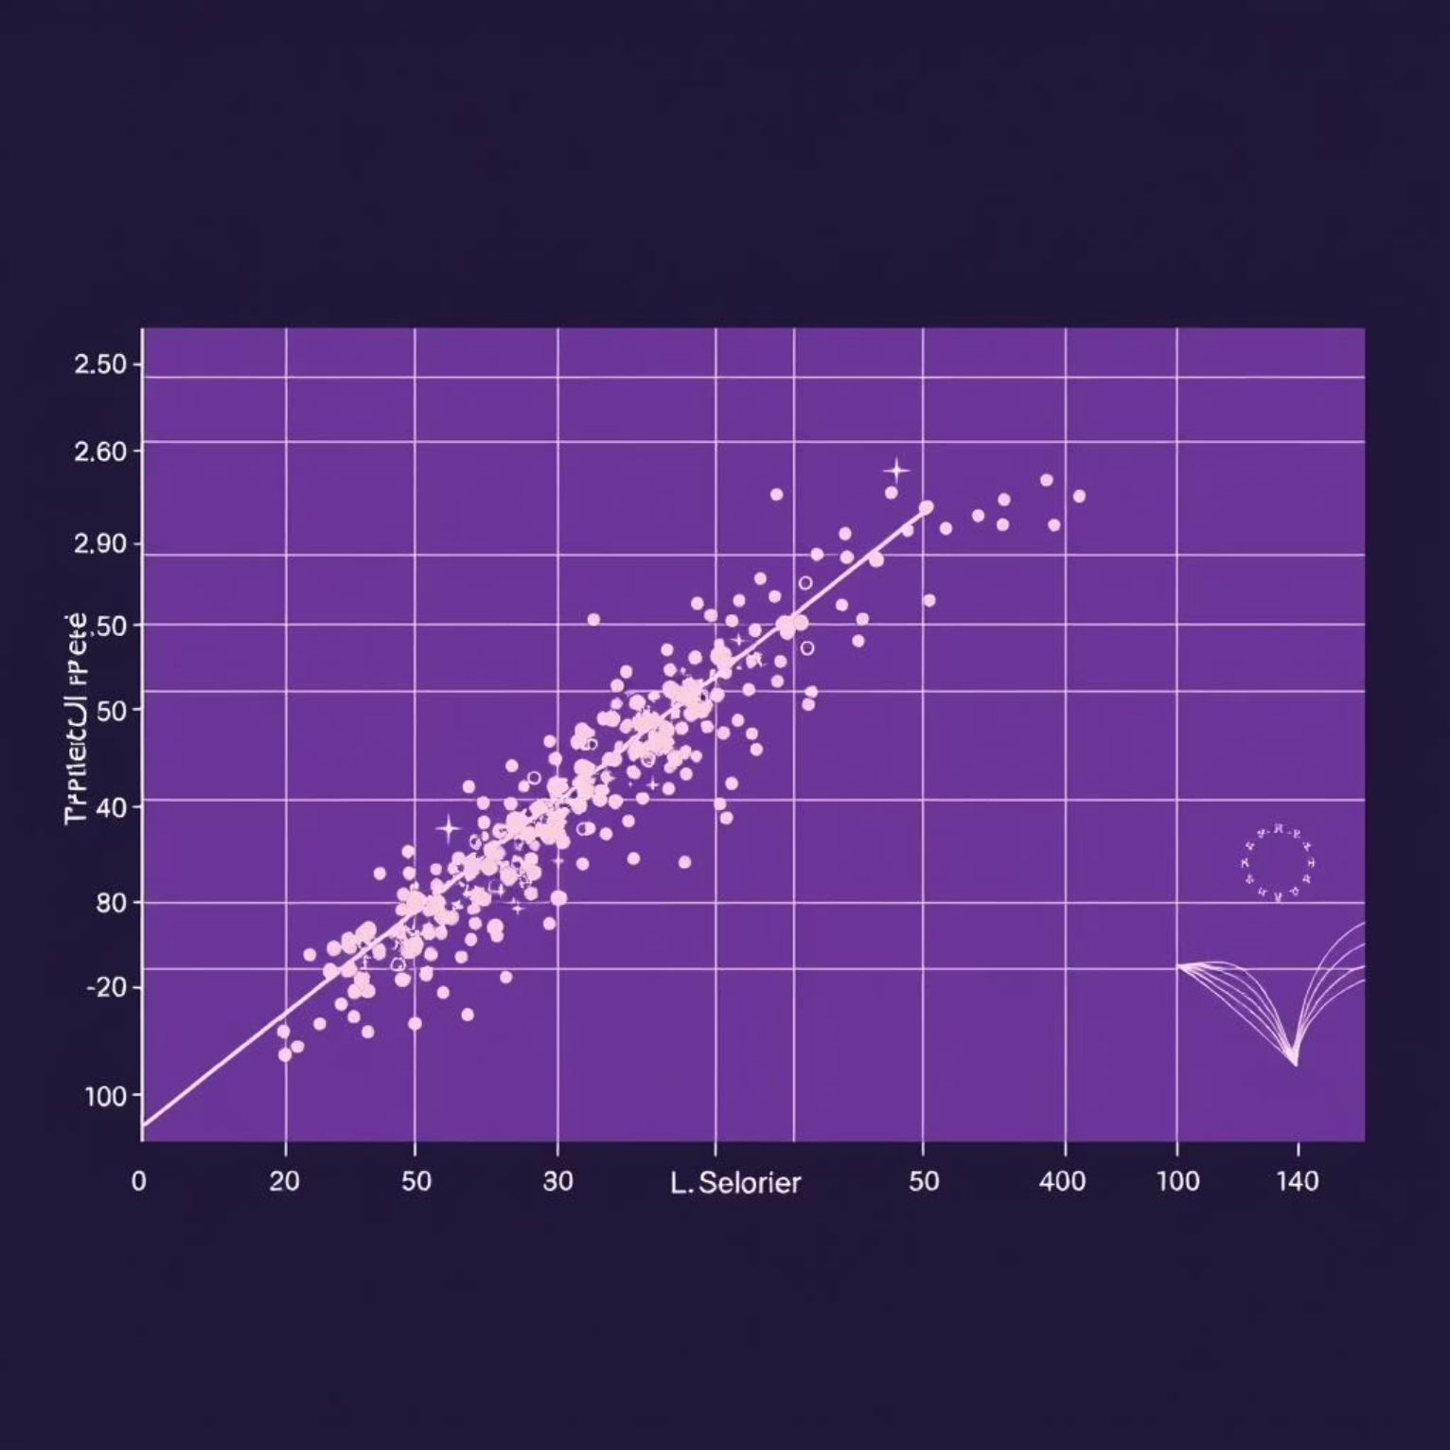
Model Validation & Testing
Our Random Forest model was rigorously tested on unseen data to ensure its generalization capabilities and predictive accuracy. The results confirm its robust performance in estimating laptop prices, making it a reliable tool for market analysis.
Test Set Performance
R² Score: 0.82 (on unseen test data)
Predictive Accuracy: The model explains 81% of the variance in laptop prices, closely aligning predicted values with actual market prices.
Reliability: Demonstrates strong ability to predict prices for new, unobserved laptop configurations, reflecting its robustness.
Limitations & Future Enhancements
Outliers: Performance can be sensitive to extreme price outliers, which may require further handling.
New Technologies: Requires periodic retraining to adapt to new laptop components and market trends, ensuring continued relevance.
Visual representation of predicted vs. actual prices, highlighting the model's strong correlation.

Slide 12
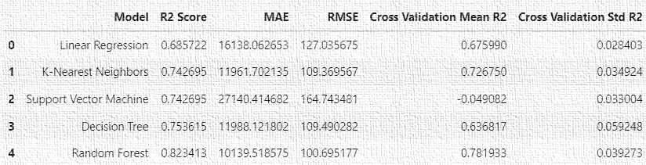


Model Performance Deep Dive
A thorough evaluation of our machine learning models reveals nuanced performance characteristics beyond just the R² score, providing insights into their robustness and generalization capabilities.
The detailed metrics above highlight the performance of each model across various evaluation criteria.
R² Score Comparison
Analysis Questions
The comparative analysis raises critical questions:
Why does Random Forest consistently outperform other models in both R² and cross-validation? Its ensemble nature and ability to handle non-linear relationships likely contribute to its robustness.
What causes SVM's negative cross-validation R² score, despite a reasonable R² on the training set? This often indicates severe overfitting or poor hyperparameter tuning, leading to failure on unseen data.
How can we further optimize the best-performing model for deployment?
This chart visually confirms Random Forest's superior predictive power, achieving the highest R² score.

Slide 13
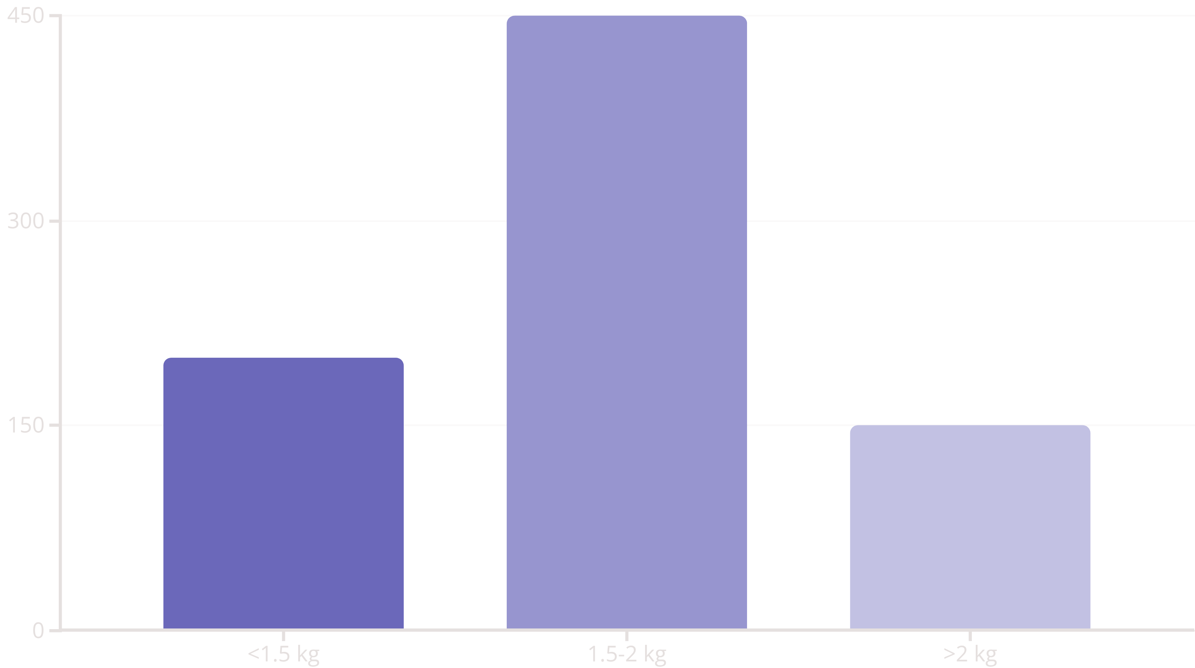
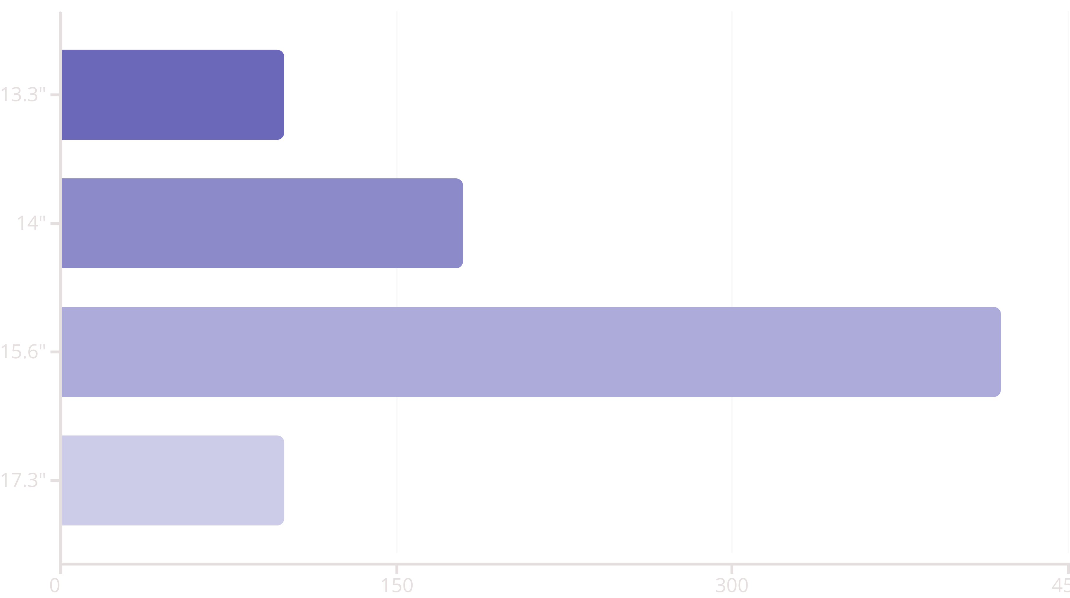
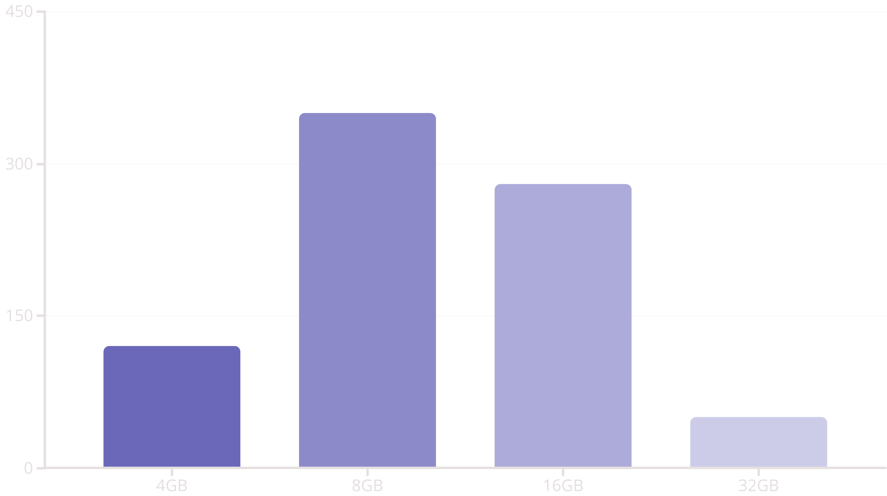
Data Distribution Analysis
Understanding the distribution of key laptop features provides valuable insights into market supply, common configurations, and potential areas for strategic pricing.
Analysis Questions
What does the RAM distribution tell us about market preferences for performance versus budget?
How does screen size distribution correlate with specific laptop categories (e.g., ultrabooks vs. gaming laptops)?
Data Patterns & Insights
The prevalence of 8GB/16GB RAM suggests a sweet spot for consumer needs, balancing cost and capability.
The dominance of 15.6" screens indicates a strong demand for standard-sized, versatile laptops.
Weight distribution suggests a preference for moderate portability, with very light or very heavy laptops being niche.

Slide 14
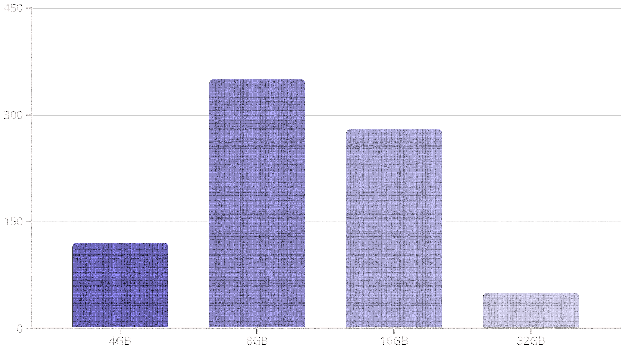
Data Distribution Analysis
Understanding the distribution of key laptop features provides valuable insights into market supply, common configurations, and potential areas for strategic pricing.
RAM Distribution
The majority of laptops fall into the 8GB and 16GB RAM categories, reflecting current market standards for performance.

Slide 15
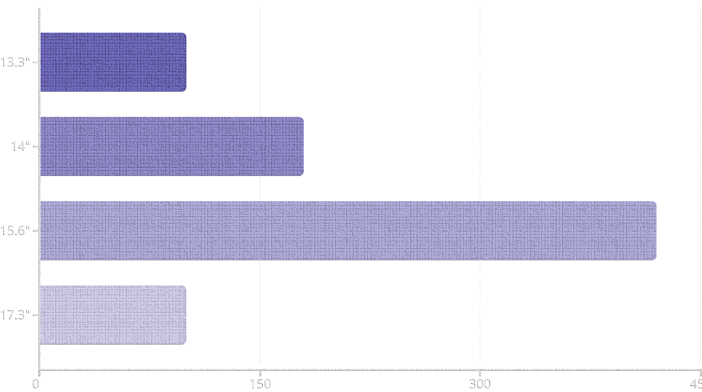
Data Distribution Analysis
Understanding the distribution of key laptop features provides valuable insights into market supply, common configurations, and potential areas for strategic pricing.
Screen Size Distribution
15.6-inch displays dominate the market, indicating a preference for larger screens, likely due to productivity and multimedia usage.

Slide 16
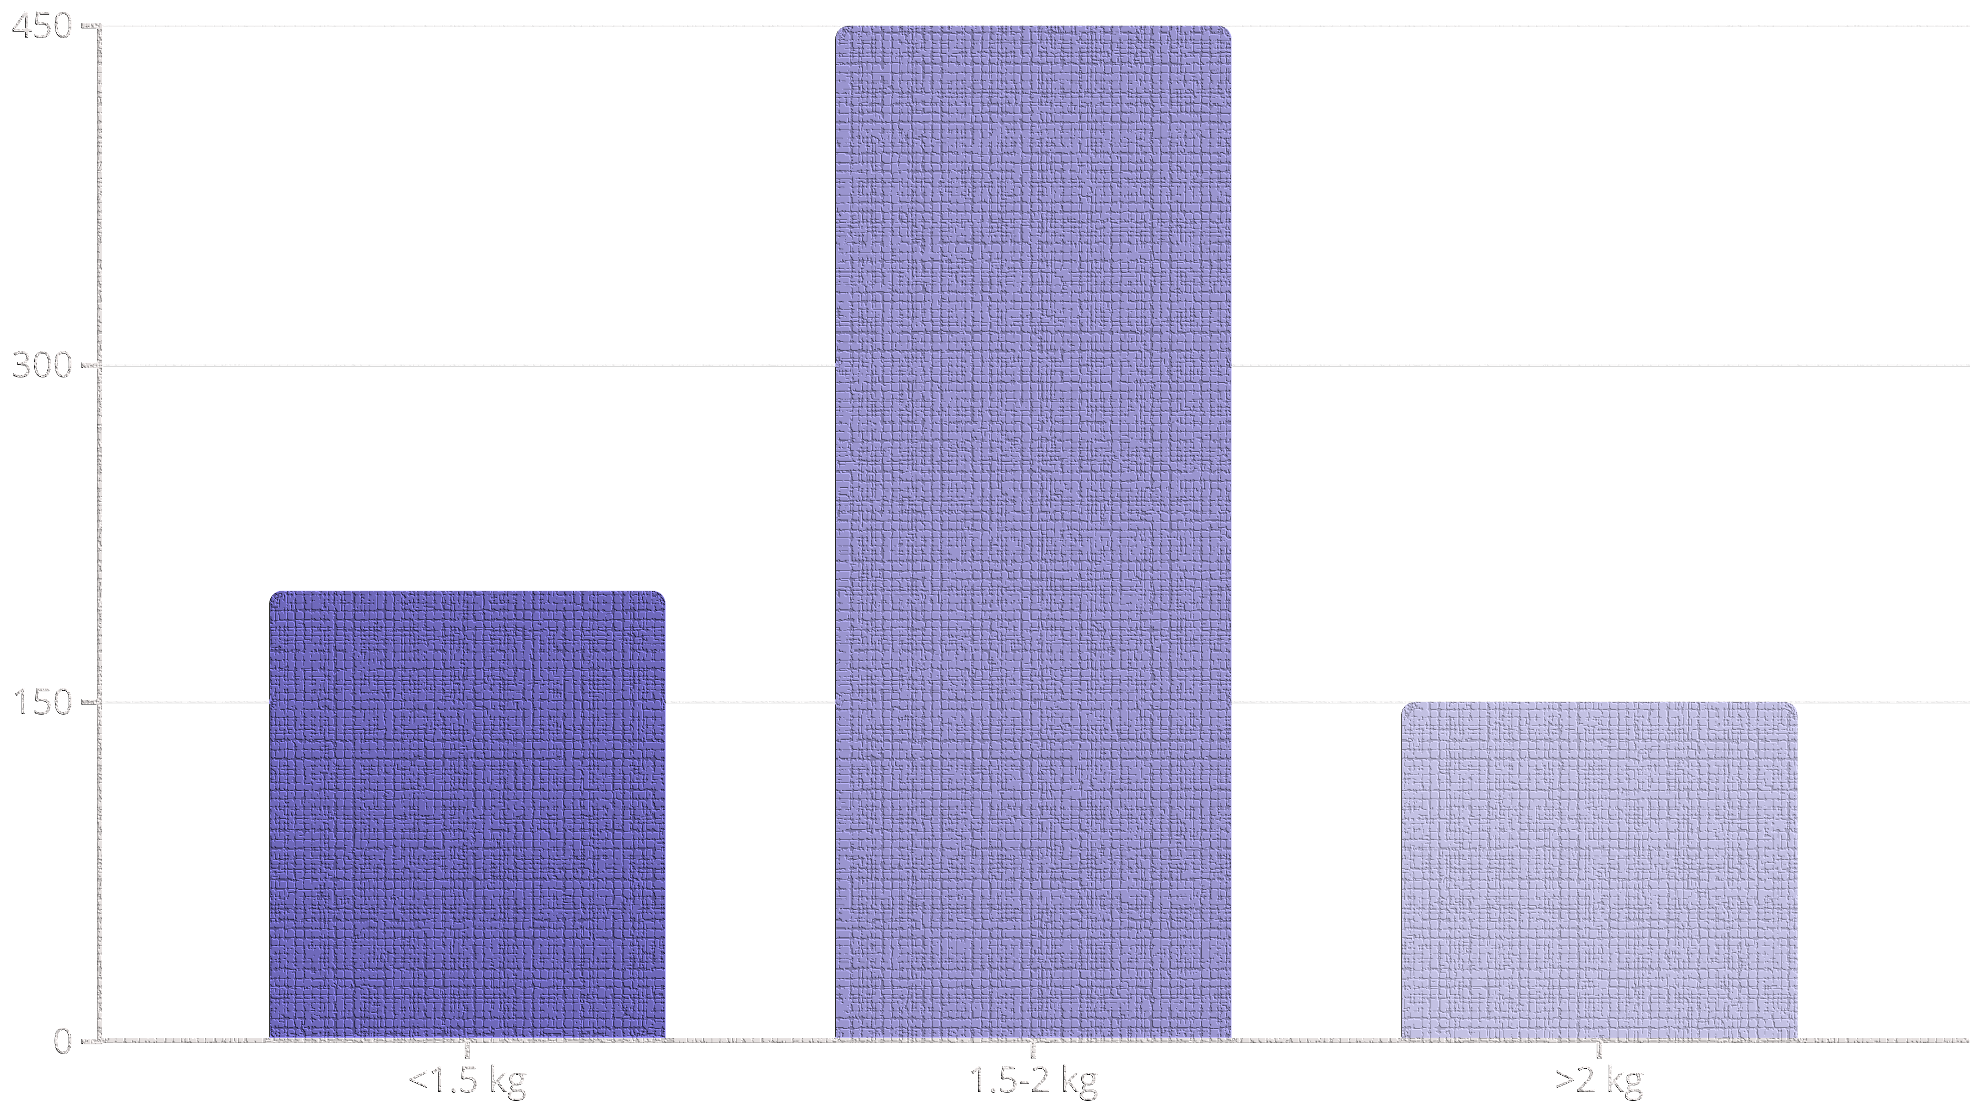
Data Distribution Analysis
Understanding the distribution of key laptop features provides valuable insights into market supply, common configurations, and potential areas for strategic pricing.
Weight Distribution
Mid-range weight (1.5-2 kg) is most common, balancing portability and performance needs.

Slide 17




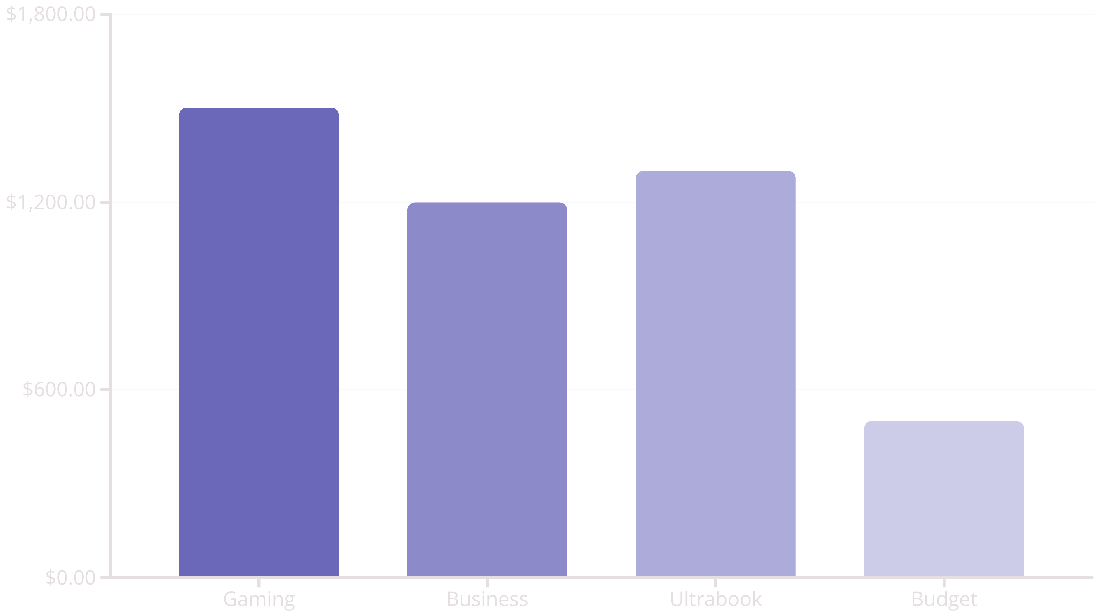
Market Segment Analysis
A detailed examination of price distributions across different laptop categories reveals distinct market dynamics and consumer value propositions, crucial for targeted strategies.
Gaming Laptops
Business Laptops
Characterized by high-end processors, dedicated graphics cards, and advanced cooling. These command premium prices with significant variability based on component specifications and brand prestige. Performance drives pricing.
Prioritize reliability, security features, and durability. Pricing is typically moderate to high, with less variability than gaming, reflecting enterprise-grade components, extended warranties, and professional software bundles.
Ultrabooks
Budget Laptops
Defined by their thin and light design, long battery life, and often premium build materials. They feature higher prices driven by advanced engineering and aesthetics, showing moderate price variability related to design and component efficiency.
Focus on affordability and essential functionality. These have the lowest average prices and minimal variability, targeting cost-conscious consumers. Pricing is driven by cost-effective components and streamlined features.
Average Price by Segment
Analysis Questions
Which segment exhibits the highest price variability, and why?
What are the primary drivers of premium pricing within each category?
How do market trends in component costs impact each segment differently?
Market Positioning & Strategies
Gaming and Ultrabooks compete on innovation and user experience, justifying higher margins.
Business laptops focus on total cost of ownership and reliability for enterprise clients.
Budget segment success relies on economies of scale and efficient supply chains.
The chart illustrates the distinct average price points for each laptop segment, confirming the premium associated with specialized features.

Slide 18




Business Applications & Recommendations
Our laptop price prediction model offers strategic advantages across the entire value chain, empowering informed decisions for various stakeholders.
For Manufacturers
Optimize pricing for new laptop models and assess the impact of component upgrades on market value. Adjust production strategies based on predicted demand at various price points.
For Retailers
Implement dynamic pricing strategies to maximize sales and manage inventory efficiently. Gain a competitive edge by accurately pricing products against rivals.
For Consumers
Make more informed purchasing decisions, identify fair market values, and leverage insights for better negotiation when buying a new laptop.
Actionable Recommendations
Integrate: Embed the model into existing CRM, ERP, and e-commerce platforms for real-time pricing intelligence.
Monitor & Retrain: Regularly update the model with new market data and technological advancements to maintain accuracy.
Strategic Pricing: Utilize insights to develop competitive pricing strategies, promotions, and product bundles.

Slide 19

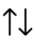

Conclusion & Future Outlook
Our comprehensive analysis and robust machine learning model provide a powerful tool for understanding and predicting laptop prices.
Model Success
The Random Forest model achieved a high R² score of 0.82, demonstrating strong predictive accuracy on unseen data.
Key Insights
RAM, SSD, and CPU brand are the most significant drivers of laptop price, offering clear targets for strategic decision-making.
Next Steps
Continuous Improvement: Regularly update the model with new data and technologies to maintain its accuracy and relevance.
Expand Scope: Explore extending the model to predict prices for other electronics or product categories.
Integrate into Operations: Implement the model into business workflows for dynamic pricing, inventory management, and personalized recommendations.
Questions & Discussion
Thank you for your time and attention. We are now open for any questions or further discussion.

Slide 20


Access Our Solution
Jupyter Notebook & Code
Complete analysis and implementation
GitHub Repository
Includes data preprocessing, model training, and evaluation
Live Interactive Demo
Try the model with your own laptop specifications
Streamlit App
Get instant price predictions

